Slide 1
A presentation on,
A generalized Benford’s law for JPEG coefficients and its applications in image forensics
Dongdong Fu, Yun Q. Shi, Wei Su
First appeared in Security, Steganography, and Watermarking of Multimedia Contents IX. Proceedings of the SPIE, Volume 6505, pp. 65051L (2007) by,
Gopal T Narayanan
Venkata Tetali

Slide 2
Overview of the presentation
Fundamentals
  JPEG
  Benford’s first digit law
The paper
  First digit distribution for DCT coefficients
  First digit distribution for JPEG coefficients
  Applications of the distributions
  Critique
References

Slide 3
JPEG - Overview
A popular image compression and file format standard, which allows for very high bit-savings.
Classified as a ‘lossy’ scheme, primarily because of floating point roundoff, and a principle called ‘quantization’, which we will see subsequently.
Quality of the image, and the resulting file size are complementary encoding parameters – lowering quality reduces file size and vice versa.

Slide 4


JPEG – How does it work ?
8x8 DCT
DCT Quant
Zig-zag,
Entropy Enc
Header
Lena.jpg, 512x512, Q=70, 26 KB
512x512, 1 MB
Lena.jpg, 512x512, Q=70, 26 KB
Bitstream
Parser
Entropy Dec
Inv Quant
8x8 IDCT

Slide 5
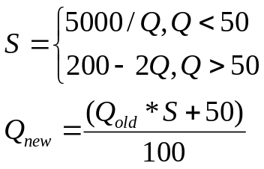
JPEG – Controlling Image Quality
Image quality is controlled using a tuning parameter called the ‘quality factor (Q)’.
Q is an integer, which ranges from 10 to 100, where 10 represents the lowest quality, and 100 the highest.
JPEG uses Q to dynamically generate a quantization table from the standard quantization table, which is specified for Q = 50.
Specifically,

Slide 6





JPEG –Image Quality Examples
Images courtesy Wikipedia
Q=100, 83 KB
Q=50, 15 KB
Q=25, 9 KB
Q=10, 4 KB

Slide 7
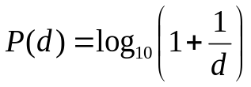
Benford’s first-digit law
In 1938, Frank Benford stated without proof, a law regarding the probability distribution of the first digits of real world numbers.
Specifically, Benford’s first digit law states that in a given data set, the digit 1 will appear more than 30 % of the times, while the rest of the digits appear at progressively diminishing frequencies, with the digit 9 appearing less than once in 20 times. Quantitatively,
This law was found to be mostly true for a variety of data sets, ranging from electricity bills to lengths of rivers. A formal proof was given for this in 1995 by Ted Hill (GATech).

Slide 8
The paper - Introduction
This paper applies Benford’s first digit law to DCT coefficients and JPEG coefficients.
It gives a generalized Benford’s law for JPEG coefficients, which do not follow the original law for reasons that we will explore subsequently.
It explores applications of these first digit distributions in forensics applications.

Slide 9

The paper – First digit rule for DCT coefficients
It turns out that the DCT coefficients follow the Benford’s law rather strictly.
But before that, a few concepts need to be explained briefly.
What is a DCT ?
The Discrete Cosine Transform (DCT) is a frequency space transform, very similar to the DFT, except that it expresses a signal as a sum of cosines only, thereby implying that the input signal is assumed to be real valued and to have even symmetry. Unlike a DFT, the DCT has zero phase, and is entirely real.
What does it look like, as an equation ?
There are 8 forms of DCT, of which Type-II is the most common one, and is the one used in JPEG. It is defined as,

Slide 10
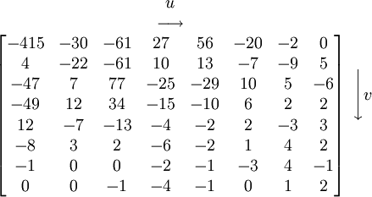
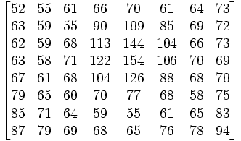
The paper – First digit rule for DCT coefficients
Why DCT ?
It has been shown¹ that the DCT has a very desirable energy compaction property, specially in the lower frequency areas. That is, a DCT’d signal has significant lower frequency components. In the case of JPEG, it allows for easier quantization and ‘serialization’.
What does a DCT’d image block look like ?
DCT

Slide 11
The paper – First digit rule for DCT coefficients
As an aside, it was observed by Smoot and Rowe², and independently by Reininger and Gibson³, that the DCT coefficients of an image, generally follow the Laplacian distribution (2-sided exponential).
The focus of this paper, however, is the distribution of the first digits of the ‘AC’ DCT coefficients. The ‘AC’ coefficients are all coefficients in a DCT block, except the one at (0, 0). This paper states that their distribution follows Benford’s first digit law closely.
This is true because Benford’s law, in general applies to data sets which cover large orders of magnitude (DCT magnitudes range from 0 through 10 to well over 500).
This has been confirmed by our experimental results. We have tested it over only a few images, but the results are ostensibly accurate.

Slide 12
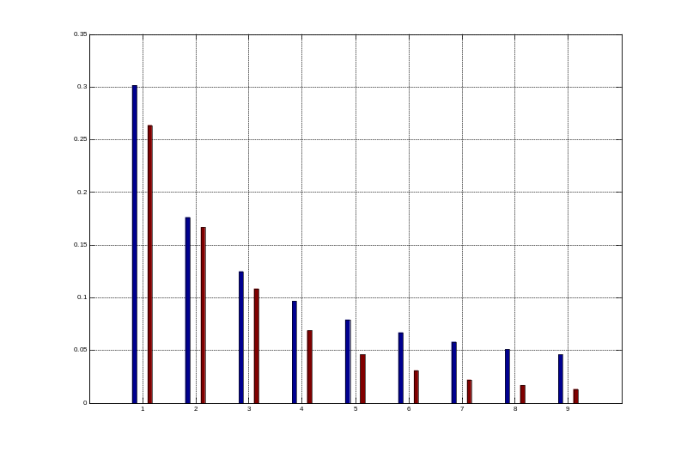

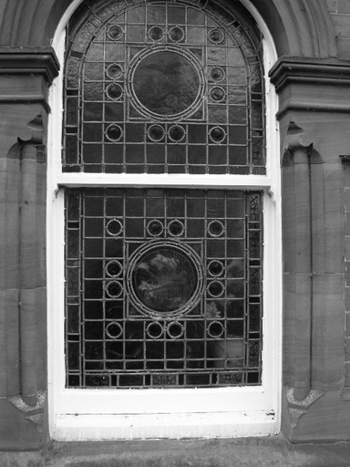
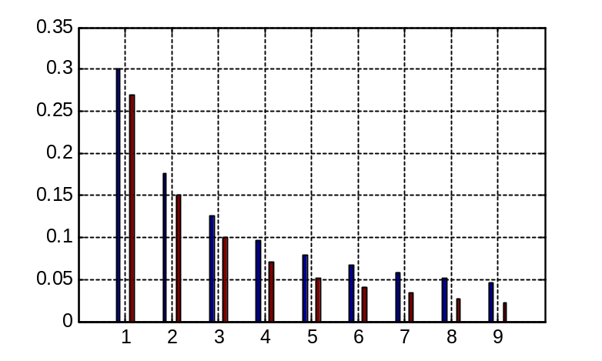
The paper – First digit rule for DCT coefficients
lena.tif
Lena - DCT first digit versus Benford’s law
ucid21gray.tif
UCID21 Gray - DCT first digit versus Benford’s law

Slide 13
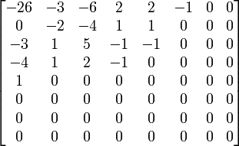
The paper – First digit rule for JPEG coefficients
This paper goes further to suggest a modification to Benford’s first digit law, to accommodate the first digit distributions of the AC JPEG coefficients.
What are JPEG coefficients ?
During the process of JPEG encoding, the DCT block is followed by a ‘quantization block’, which divides the DCT matrix by a calculated quantization matrix. This process essentially truncates the higher frequency DCT coefficients. The coefficients generated hence, are known as JPEG coefficients.
The quantization matrix used is specified by the standard, and modified to suit quality factor considerations.

Slide 14
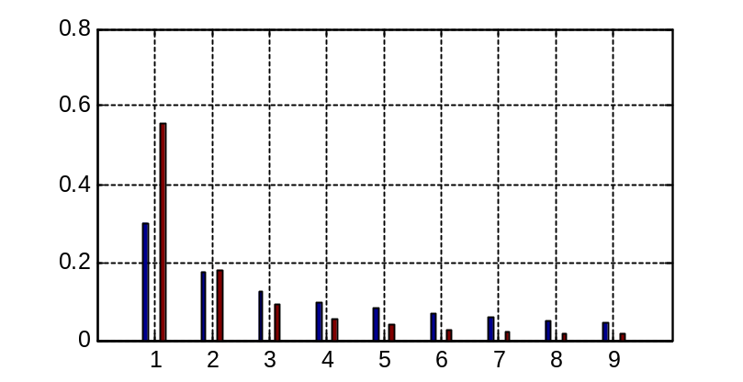
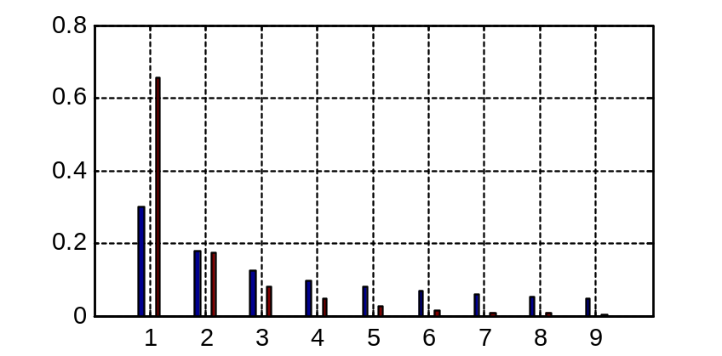
The paper – First digit rule for JPEG coefficients
Does quantization change the first digit distribution ?
Quantization does change the first digit distribution. The bar graphs shown depict the first digit distributions at two different quality factors. It is of note that the falloff is far steeper than in the case of DCT coefficients.
Why does this happen ?
When a quantization occurs, a smaller data set is generated (considering that plenty of digits go to 0), and the dynamic range is now compressed. Benford’s law will no longer be strictly followed. Instead, data with leading digit 1 will dominate the PDF.
Q = 80
Q = 20

Slide 15
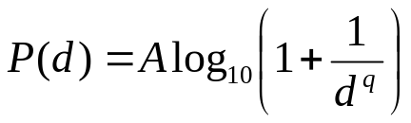
The paper – First digit rule for JPEG coefficients
Development of the modification to Benford’s law:
Now that there are far more coefficients with a leading digit of 1, and the graphs have tended to fall off rather steeply, it may be intuitively derived that the PDF should be something like,
where A is an amplification factor, and q is a rolloff exponent.
As it turned out, this model was not sufficiently accurate. The lack of accuracy was confirmed by MATLAB®’s curve fitting tool, where the average sum of squared errors (SSE – a measure of the goodness of fit) was found to be in the order of 10⁻³, which is insufficiently high.

Slide 16
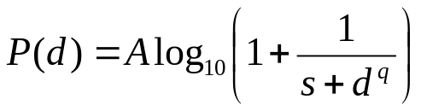
The paper – First digit rule for JPEG coefficients
The primary problem with the above probability distribution was found to be that it was not accounting for small, but significant departures of the actual coefficients from the fitted values. This was especially obvious at higher quality factors. The table shows how the SSE is increasing with Q.
It was then decided to use a third parameter, which would fine-tune the values so the SSE would be minimized. This parameter, denoted as ‘s’, resulted in,
Q | SSE
10 | 3.92e-006
20 | 2.888e-005
50 | 0.0002136
70 | 0.0004158
90 | 0.001342
100 | 0.003377

Slide 17
The paper – First digit rule for JPEG coefficients
This distribution works much better, and minimizes SSE significantly, as shown in the table below.
It is of interest that to a large extent, none of the parameters show a general monotonicity, which may make fitting a mathematical framework to them difficult. This is indeed the case, as we shall see later.
Q | A | q | s | SSE
10 | 3.664 | 7.955 | 0.1585 | 3.983e-006
20 | 3.35 | 6.673 | 0.04781 | 2.908e-005
50 | 0.3668 | 2.417 | -0.9971 | 2.716e-005
70 | 0.2938 | 1.769 | -0.9991 | 2.079e-006
90 | 0.477 | 1.523 | -0.9768 | 1.002e-005
100 | 1.967 | 1.532 | 0.8643 | 1.012e-005

Slide 18
The paper – Applications of the general Benford’s law
The large departure of the JPEG coefficients from the original Benford’s law is a property that may be taken advantage of. The paper speaks of three applications of this property.
  Detection of previously compressed images – The idea here is that when a previously compressed image is recompressed with a quality factor of 100, it will depart from the expected distribution for 100. An image that was never compressed will not depart from the expected distribution.
  Detection of compression quality factor – The idea here is that the expected distributions are very different from each other, when different quality factors are employed. This is true of very small Q-factor changes close to 100 (95, 98 etc).
  Detection of double compression – If an image has been compressed twice, it will depart heavily from the first digit law. This may be exploited to detect double compression.

Slide 19
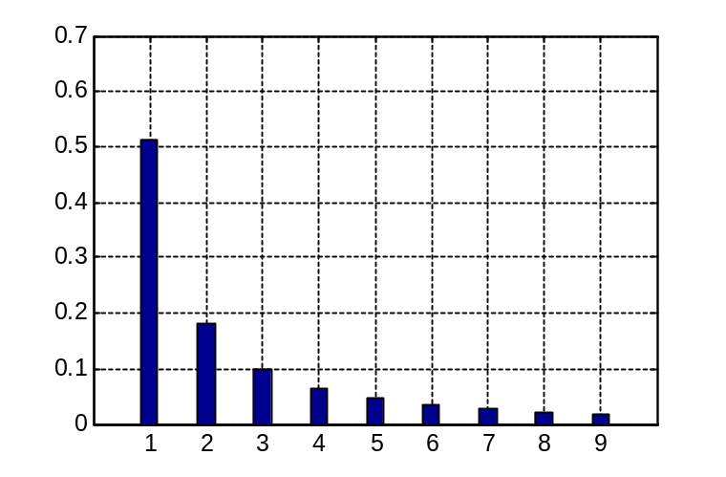
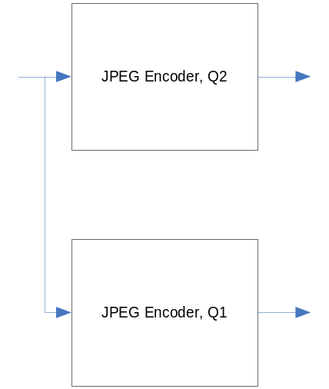
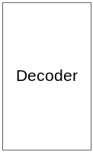
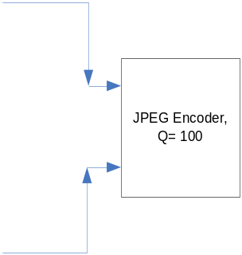
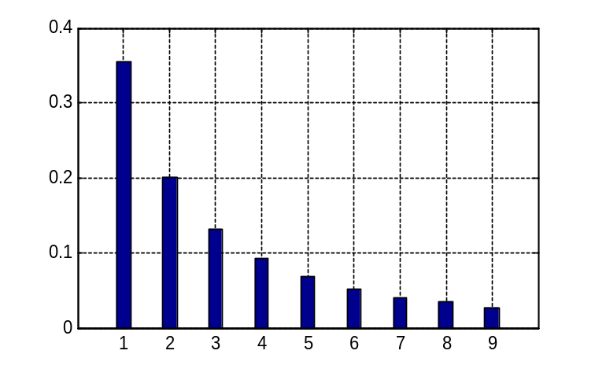
The paper – Detection of compression quality factor
Q = 95
Q1 = 100, Q2 = 95
Q = 100

Slide 20
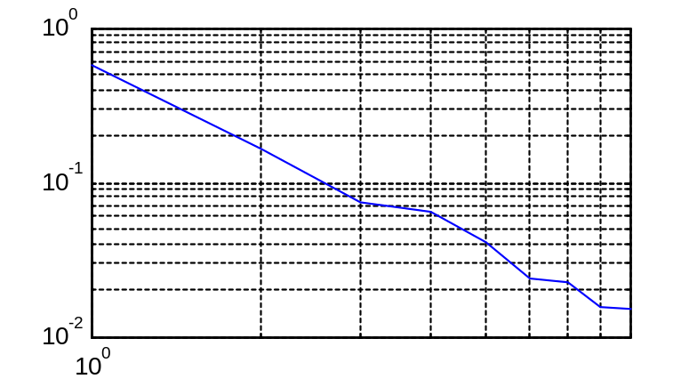
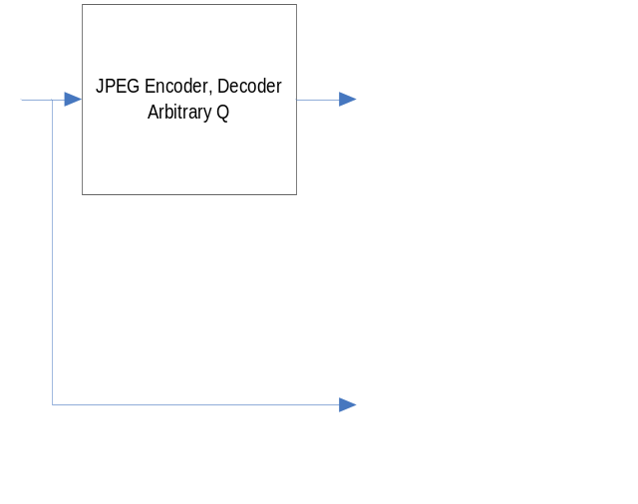
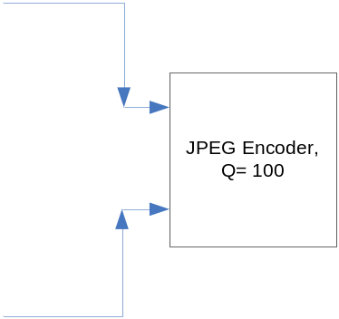
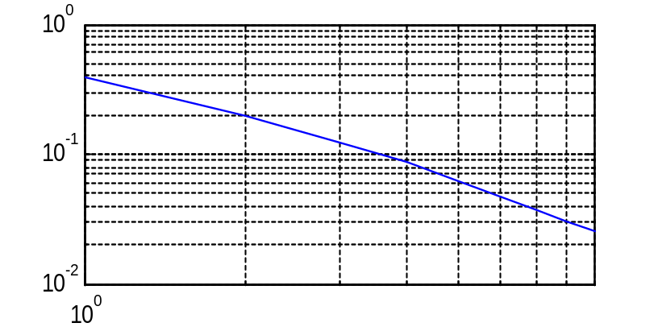
The paper – Detection of previously compressed images
Q = 50
Q=50

Slide 21
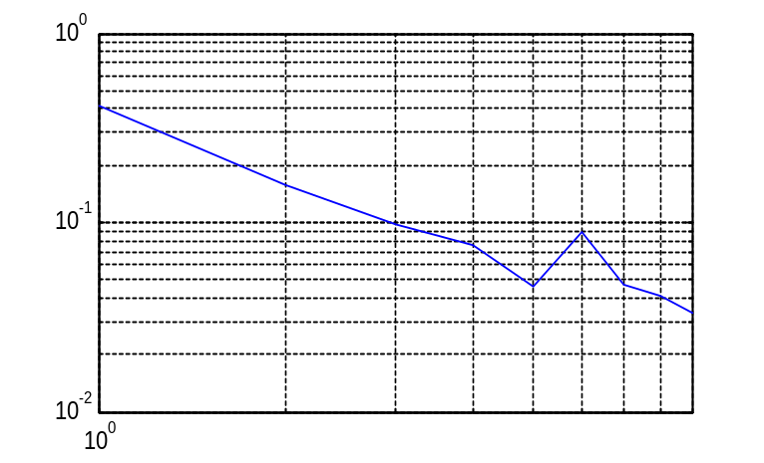
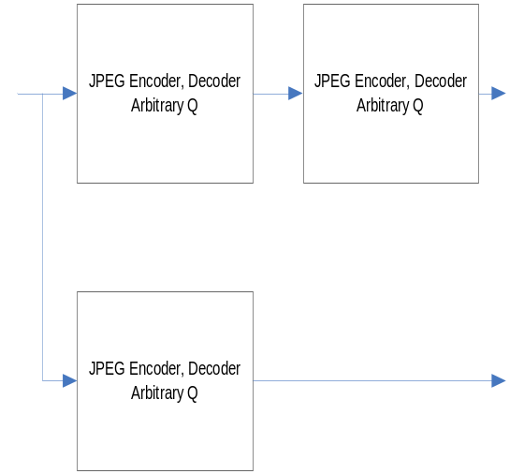
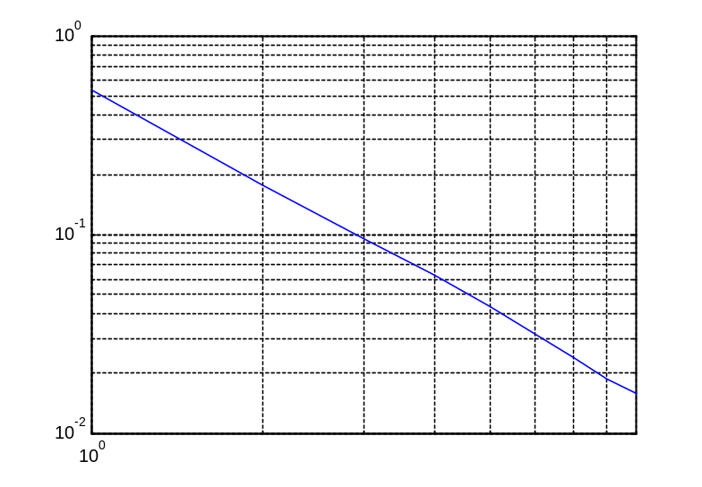
The paper – Detection of double compression
Q1 = 95
Q1 = 95, Q2=100

Slide 22
The paper – A critique
This paper is a significant work towards forensics in JPEG compressed imagery. The simplicity of various detection approaches is attractive, over, say, the approach suggested in Fan and Quieroz or Lukas and Fridrich.
The method is intuitive in that, the distribution of the first digit follows the direction of energy compaction. Furthermore, considering that a lot of real world data follows the Benford’s law very closely, it comes as no surprise that a natural metric such as DCT would yield similar results.
The paper does not, however, completely specify the generalized Benford’s law model, since it makes no mention as to how the parameters, s, q and A must be derived. An independent attempt at curve fitting the obtained values into a mathematical framework did not yield usable results, as evidenced on the next slide.

Slide 23
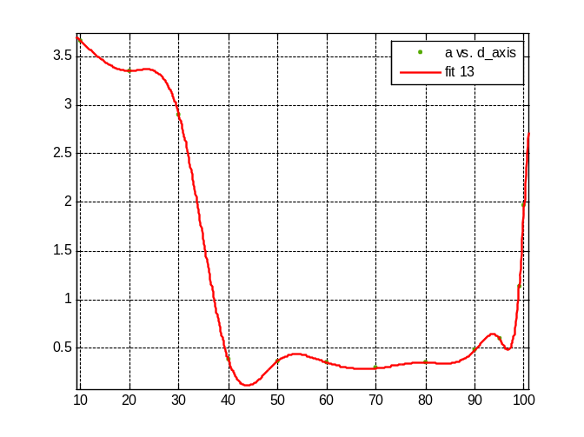
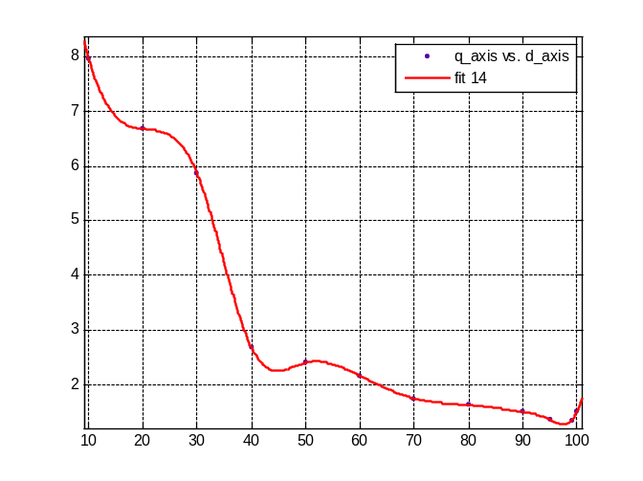
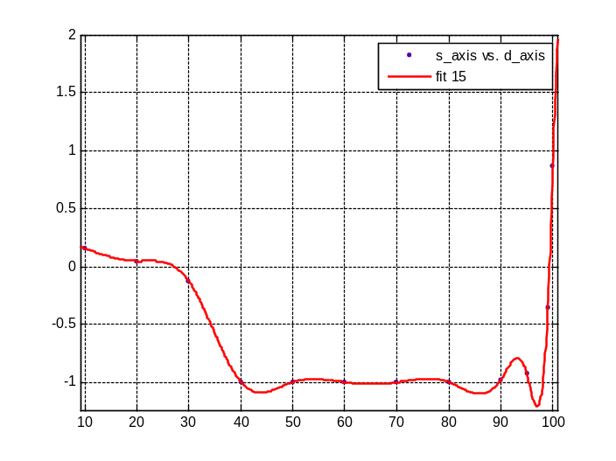
The paper – A critique
The graphs show the distribution of A, q and s over Q = [10, 100]. Continuous curve fitting failed due to excessively high SSE. The only viable models are piecewise cubic and smoothing splines.

Slide 24
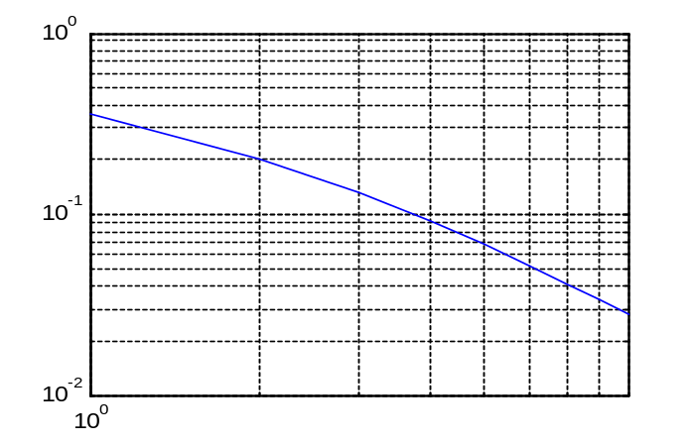
The paper – A critique
It was also found that for an image that was compressed with a quality factor of 100 the first time, and 100 the second time as well, the JPEG coefficients traced an almost linear curve (shown). This means images that have been double compressed with Q1 = Q2 = 100 will be hard to detect.

Slide 25
References
A generalized Benford’s law for JPEG coefficients and its applications in image forensics Dongdong Fu, Yun Q. Shi, Wei Su, Security, Steganography, and Watermarking of Multimedia Contents IX. Proceedings of the SPIE, Volume 6505, pp. 65051L (2007)
Study of DCT coefficient distributions, Stephen R Smoot, Lawrence Rowe, Proceedings of the SPIE Symposium on Electronic Imaging, 1996
Using JPEG quantization tables to identify imagery processed by software, Jesse D. Kornblum, ELSEVIER press
The International JPEG (IJG) reference code - http://www.ijg.org/files/
JPEG on Wikipedia - http://en.wikipedia.org/wiki/JPEG
Benford’s Law on Wikipedia - http://en.wikipedia.org/wiki/Benford's_law

